Slide 1
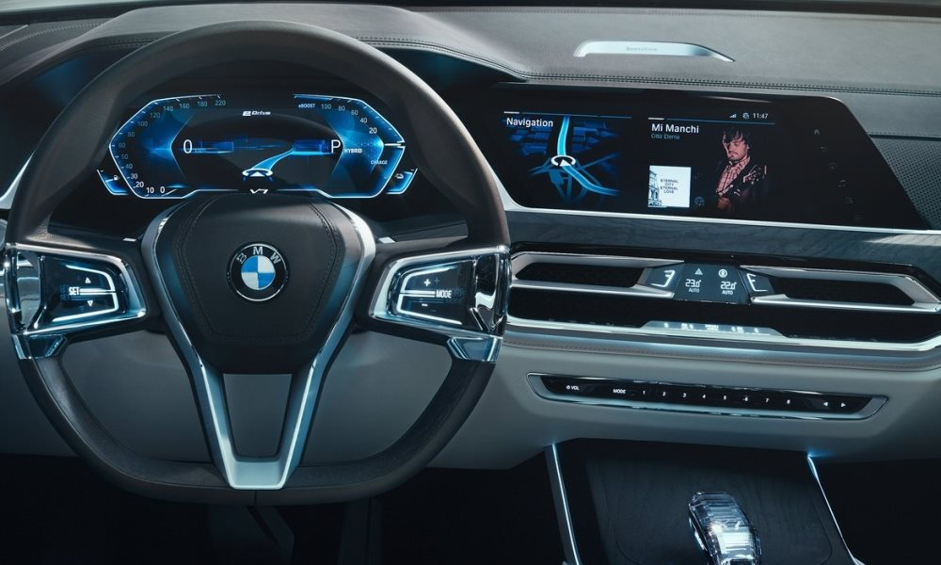
Infrastructure for BMW Test Car Display System – Part B
Project B – Spring 2019
By: Vivian Lawin & Daher Daher High Speed Digital Systems Lab (HSDSL)
Supervisor: Boaz Mizrachi Technion – Israel Institute of Technology

Slide 2
Motivation
Enhance and improve the driving experience in BMW cars in general (and BMW’s Autonomous cars in particular)
Understand and feel not only the condition of the environment and the traffic, but also the condition of the road
Improving car testing procedure (especially when intended to be driven autonomously.

Slide 3
Goals
Provide a friendly and easy-to-use application
Able to graphically display real-time data collected by car’s sensor.
Configurable
Expand base application to provide further features.

Slide 4
About Part A
A stepping-stone and basis towards real-real-time
Reading data streams from file
Transmitting over TCP (Transmitter -> Receiver)
Features:
Easy-to-use application.
Support multiple graphs (Up to 3 graphs at a time).
Choose different configurations (Resolution, Max value, Color…).
Support logging and data recording (internal memory file and in UI).
Time axis scaling.
Different appearance theme.

Slide 5
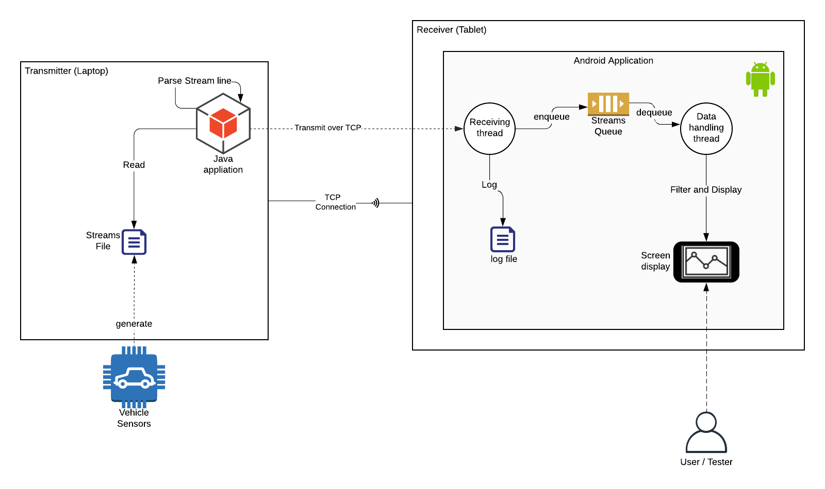

Slide 6

Part B – Features
Receive data directly from vehicles sensors
Cloud storage of test results and statistics.
Profile per user/tester

Slide 7

Part B – Features
Receive data directly from vehicles sensors
Do we get rid of transmitter?
Do we keep it?

Slide 8
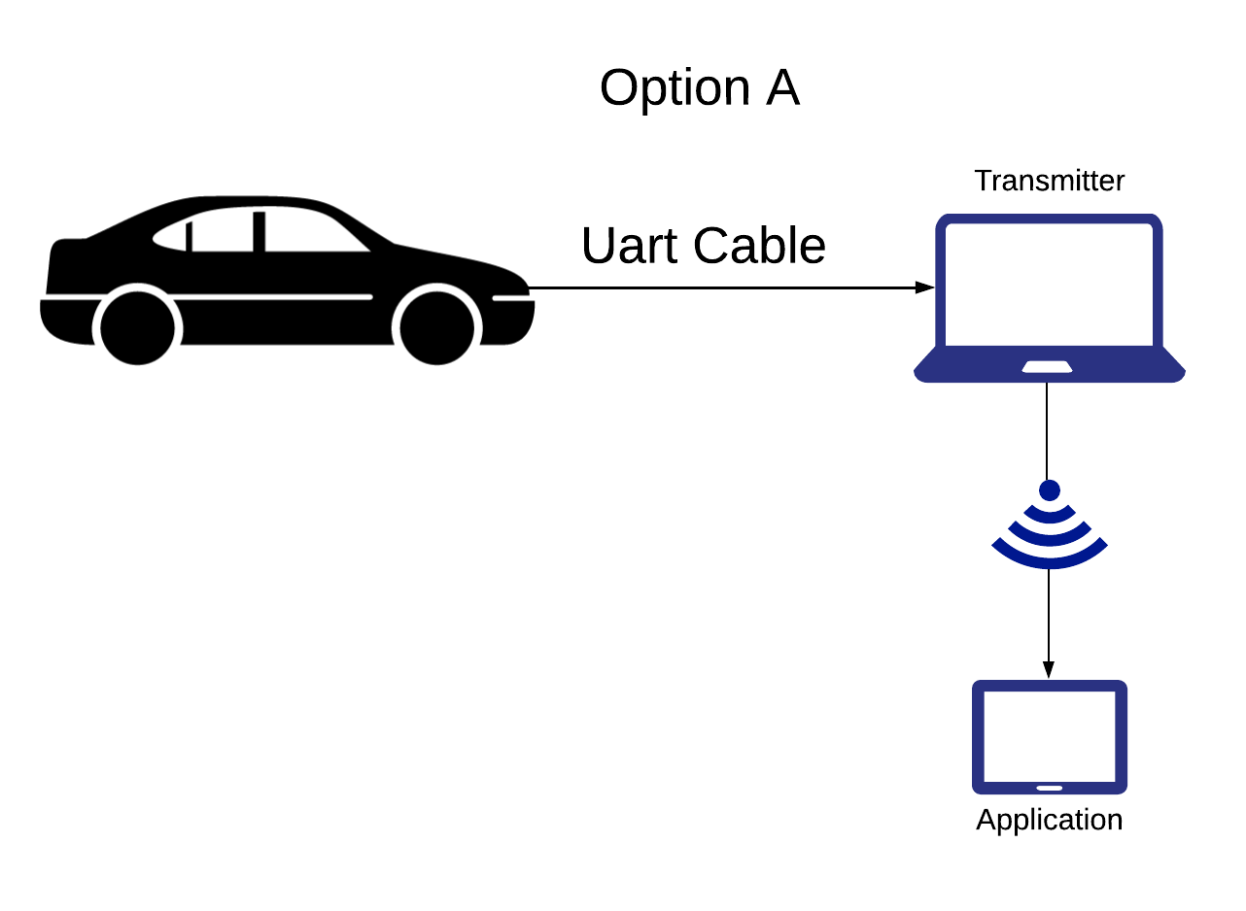
Part B – Features
Receive data directly from vehicles sensors

Slide 9
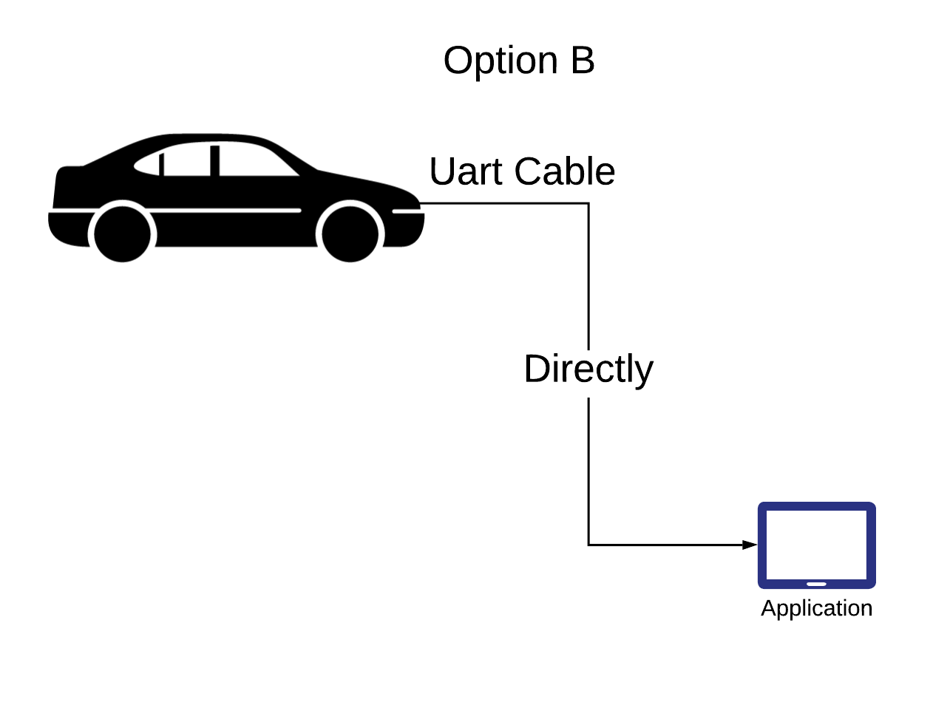
Part B – Features
Receive data directly from vehicles sensors

Slide 10

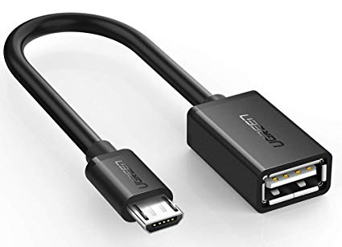
Part B – Features
Receive data directly from vehicles sensors
Option B requires:
Serial to USB
OTG cable

Slide 11
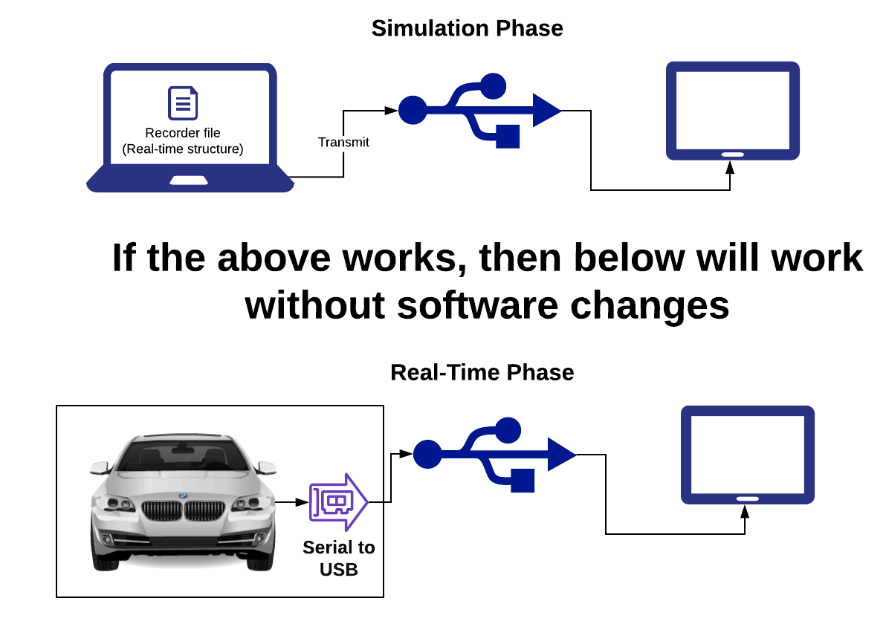
Part B – Features

Slide 12

Part B – Features
Cloud storage of test results and statistics.
Firebase
Realtime database and backend as a service.
API that allows application data to be synchronized and stored on Firebase's cloud.

Slide 13

Part B – Features
Profile per user/tester
Log-in Screen
Firebase Authentication
Retrieve user/testers data and statistics

Slide 14
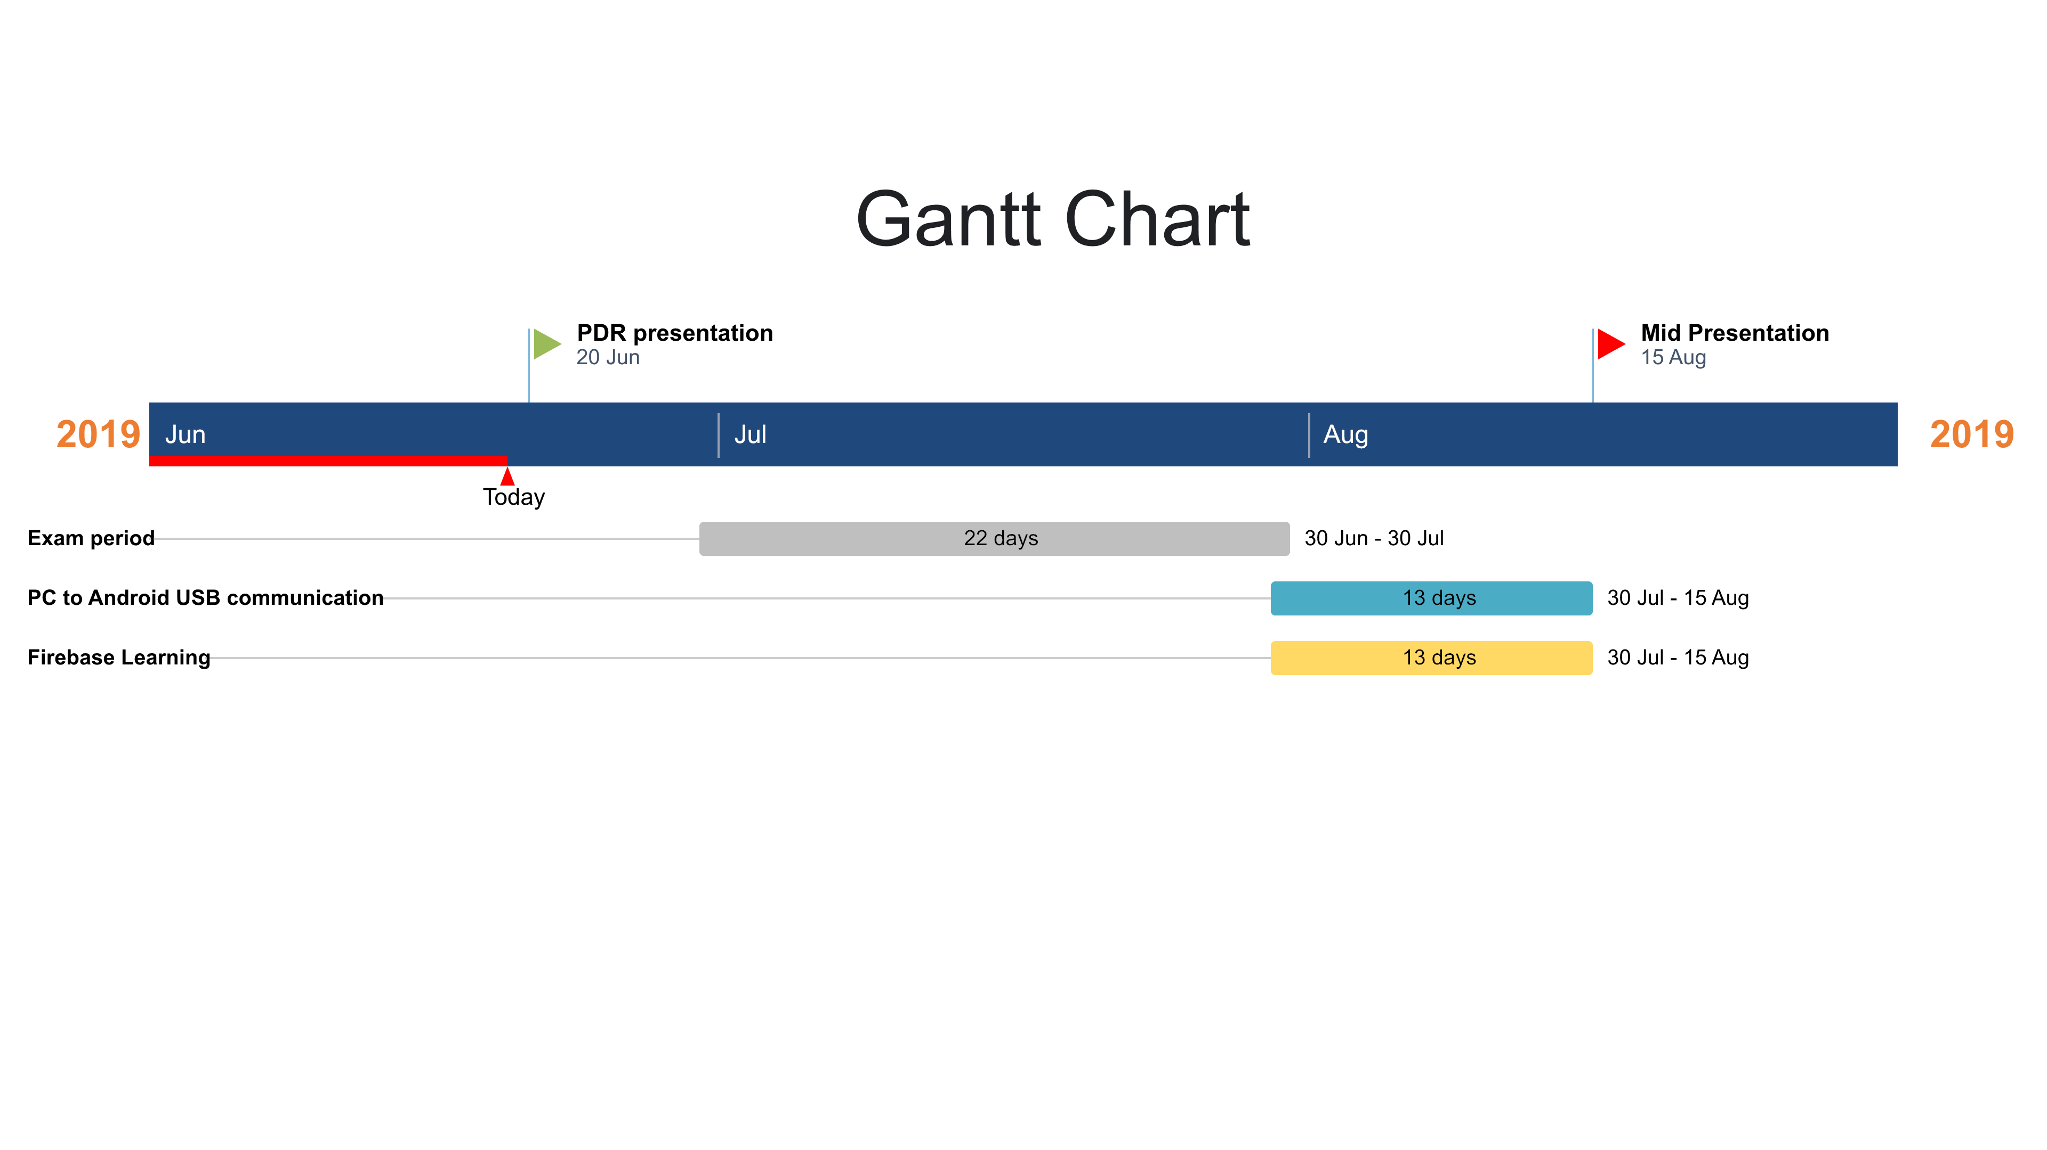
Gantt Chart

Slide 15

What’s Next?

